Slide 1
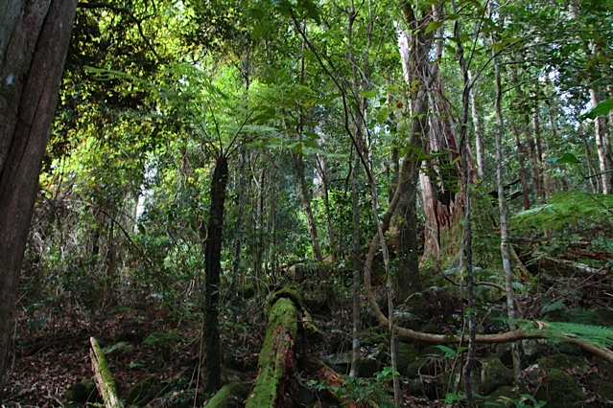
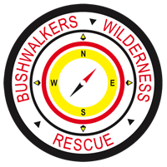
Locating VH-MDX
Glenn Strkalj
Glenn Horrocks
BWRS
25th November 2016

Slide 2
Brief approach
Part 1: General overview
Part 2: Technical update

Slide 3
BWRS position to VH-MDX
Complete original mission from 1981: Locate VH-MDX
Do not wish to engage in political, legal or self-interest based activities
Proliferate accurate VH-MDX information.

Slide 4
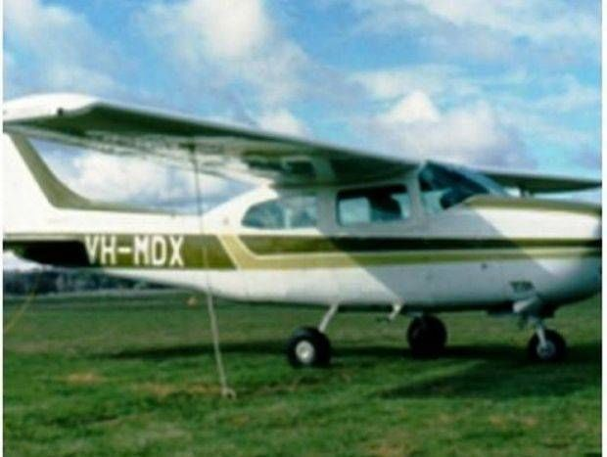
What is VH-MDX?
A single-engine light aircraft
Travelling from Proserpine to Bankstown
9th August 1981
5 people on board
Disappeared without a trace
Within or near the Barrington Wilderness Area
BWRS involved from 1st search

Slide 6
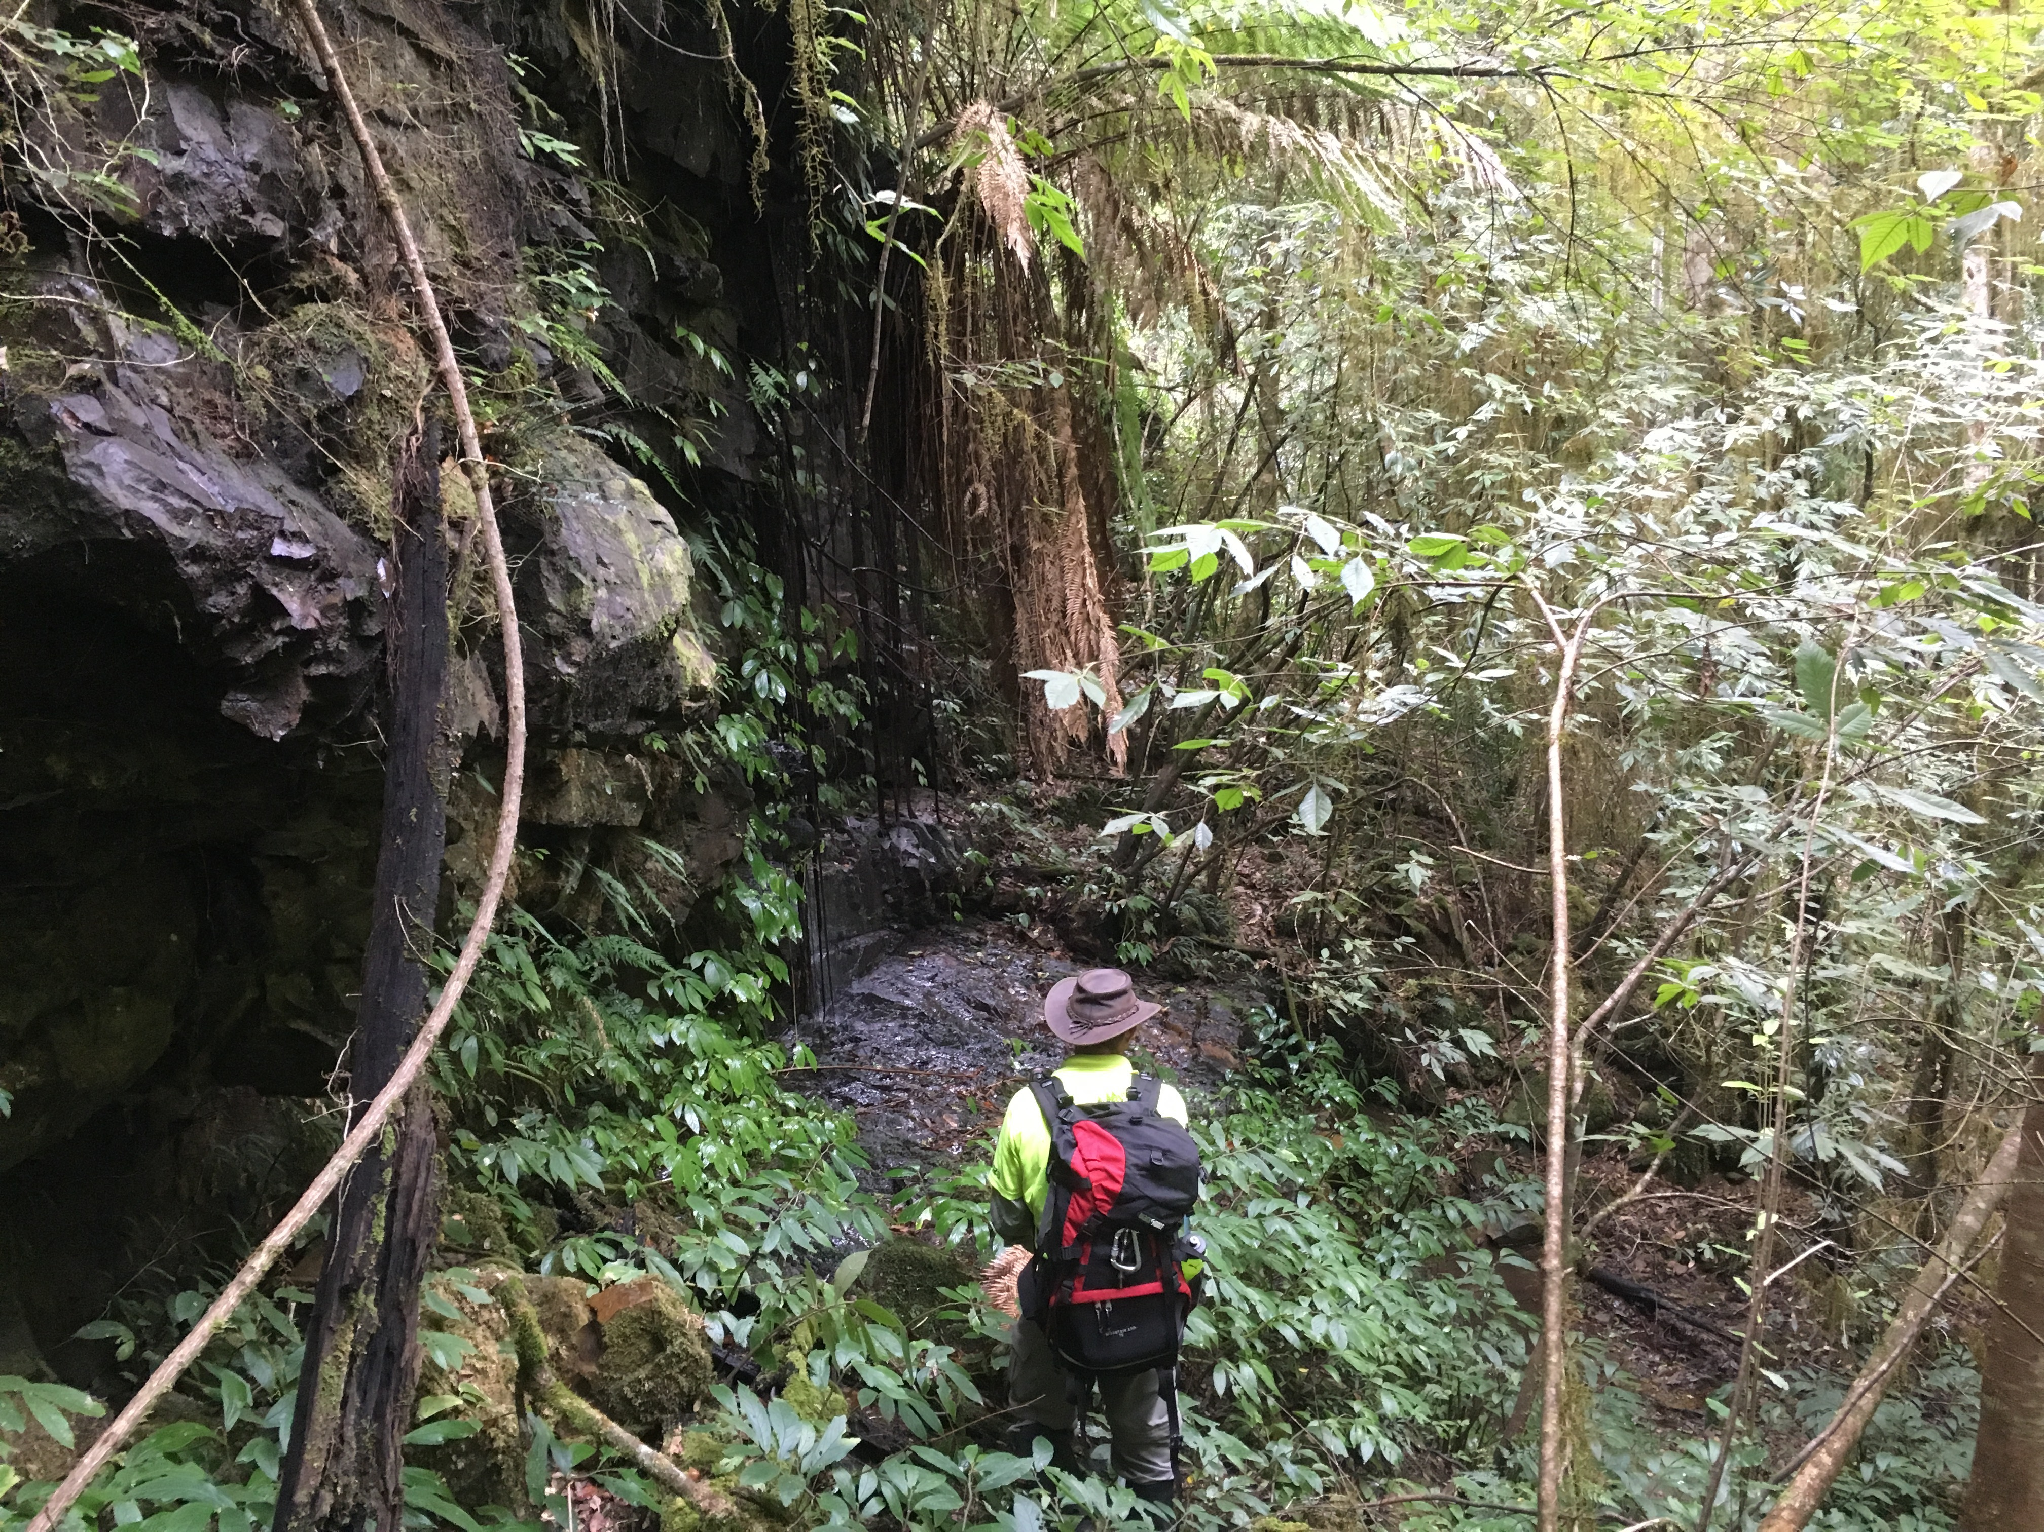
Why was VH-MDX not found?
Topography
Errors in:
base information and data
interpretation of radar fixes

Slide 7
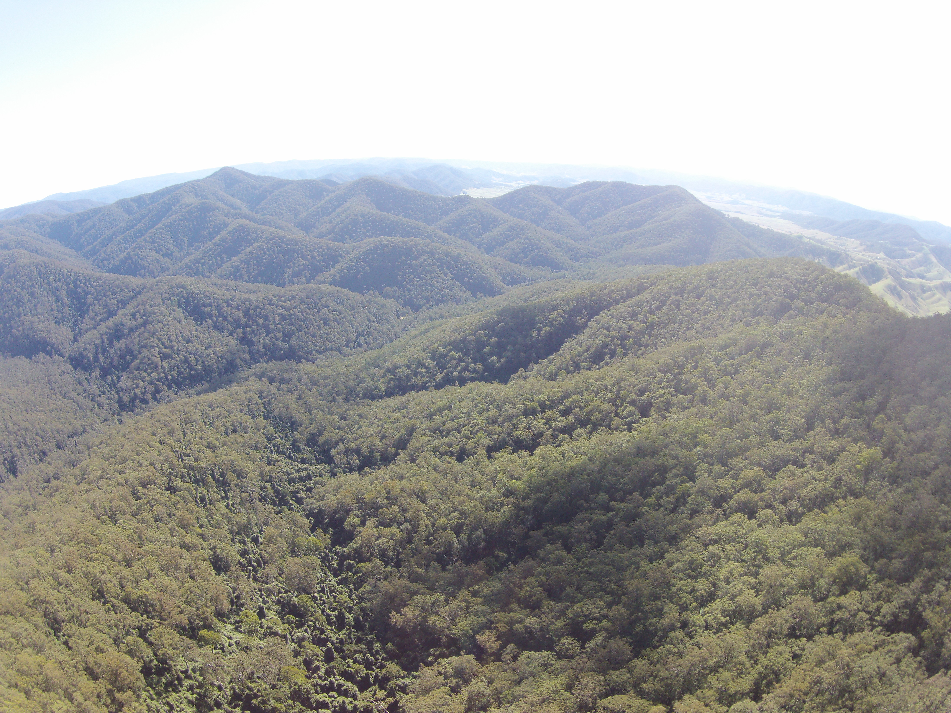
Why search for VH-MDX?
Offer closure to families and friends
Complete original BWRS mission
Excellent remote search activity for NSW emergency services
Challenge
Enjoyment
Lots of other reasons

Slide 8
Where were we pre-2014?
Limited understanding of information and data
Poor understanding of radar coverage
Incorrect assumptions on radars involved
Lots of rumors and Chinese whispers
Limited effectiveness of leadership and communication
ATCO’s not debriefed correctly or at all
Limited cross checking methods
Poor unity, poor research quality

Slide 9
What did we do about this?
Concept of Operations (CONOPS) developed
A progressive, iterative and tear down approach to research
Locate base information and data
Unfreeze previous conclusions
Multiple, hierarchical areas of interest were identified as the best method of attack rather than small areas based on heavy assumption

Slide 10
Where are we now?
Strong understanding of & significantly more information &data
Solid understanding of radar coverage & radars involved
Confirmation or quashing of rumors &Chinese whispers
Strong, effective leadership and communication
Solid command, control and co-ordination
Solid & lengthy debrief of ATCO’s
Use of alternate analysis methods
Effective and trustworthy relationships
Robust record keeping
Open sourcing information
Input from many Subject Matter Experts
Significant documentation located and analysed

Slide 11
www.vhmdx.com.au

Slide 12
How does all this help?
‘Purer’ sources of information and data
Stronger corroboration
More defensible assumptions
More defensible search areas
Truly coordinated search effort

Slide 13
How has this changed focus areas?
10km-20km shift from ‘traditional’ areas

Slide 14
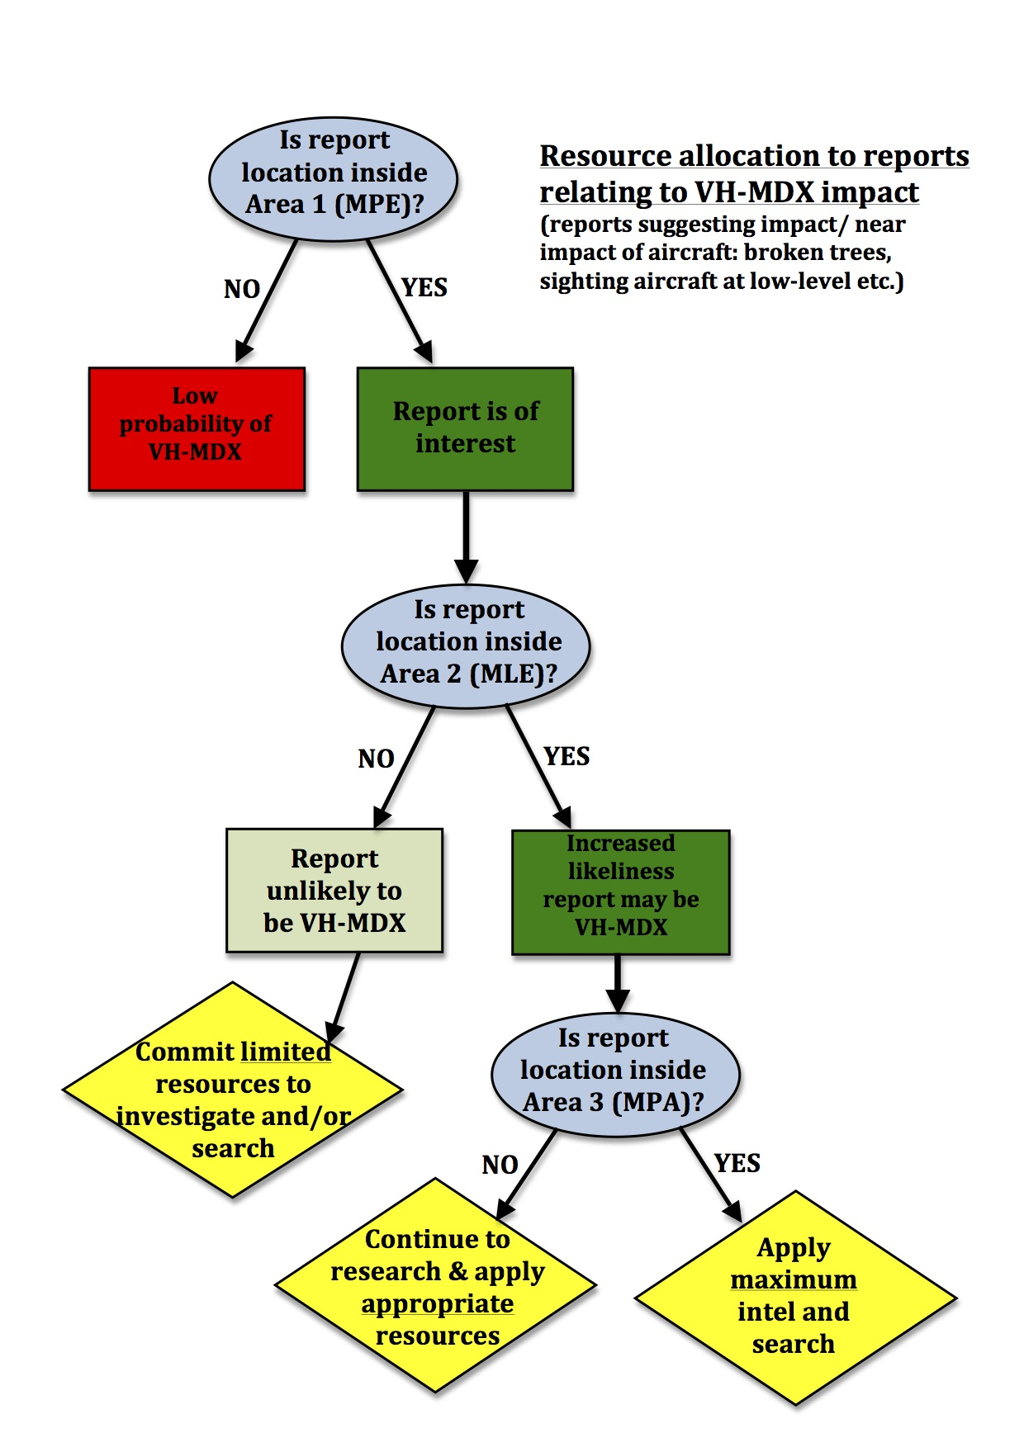
644sqkm
455sqkm (remote areas)
17sqkm

Slide 15
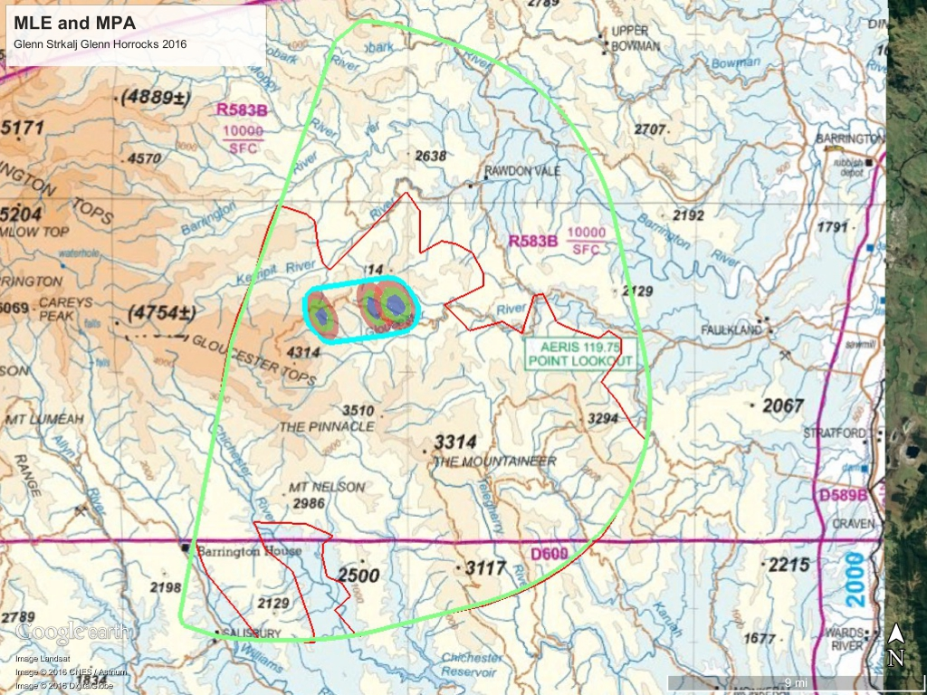
455sqkm
MPA combine topo
644sqkm
In many ways the MLE is the most important area

Slide 16
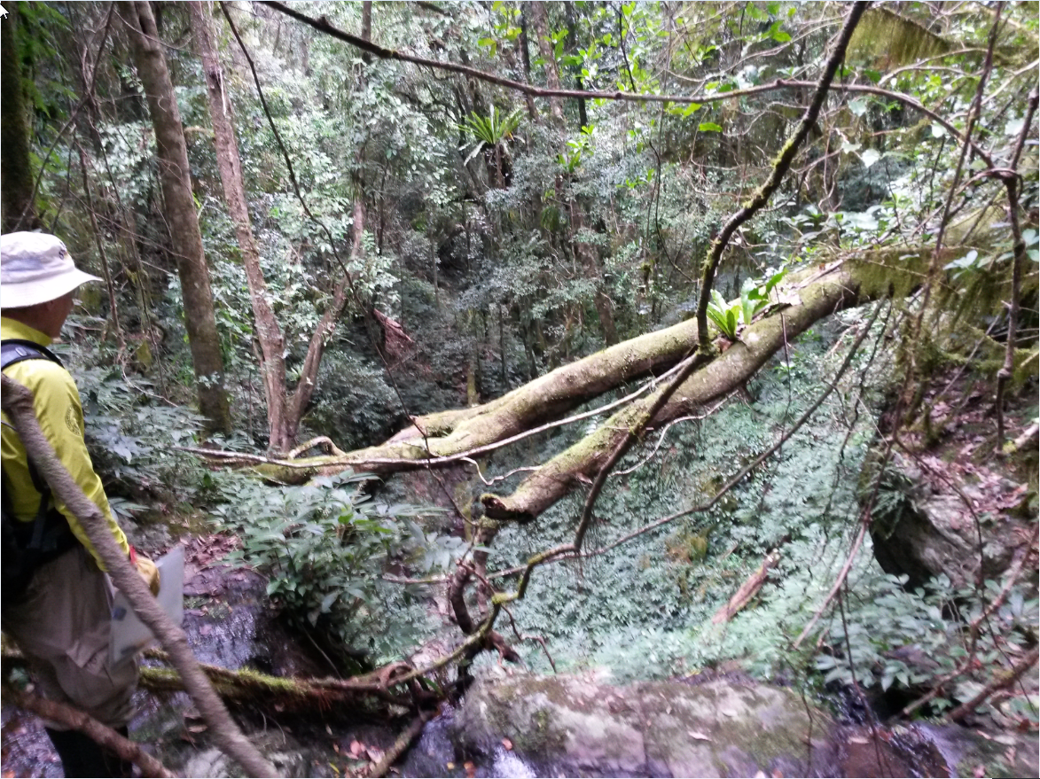
Search tactics
Mixed: contact and recce
More appropriate to topography and area of interest
‘Loose’ contour searching

Slide 17
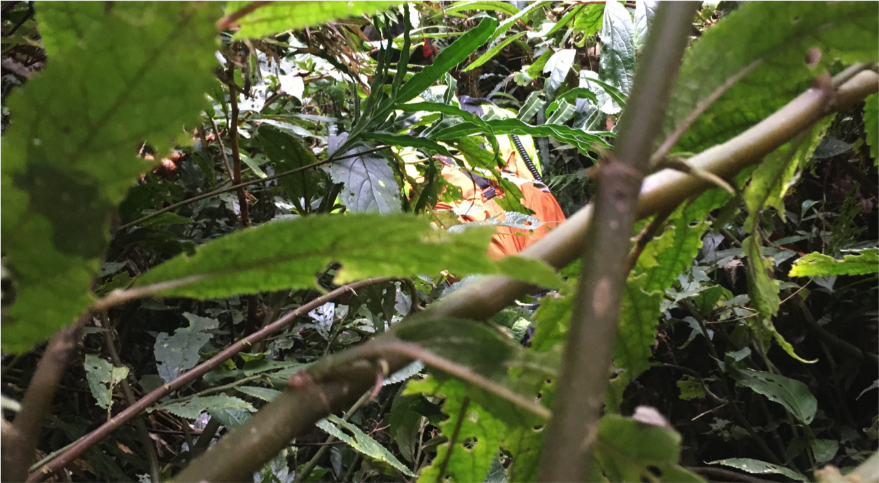
Search progress
From 2014, recce commenced UGR area
More recces in 2015
2015 Barrington SAREX was the 1st major activity in the UGR area
2016 expanded reach of recce ops in the area
2016 Barrington SAREX incorporated tactics tailored to the problem rather than solely contact searching

Slide 18
Post 2014 search activities
From 2014, recce ops commenced UGR area
More recces in 2015
2015 Barrington SAREX was the 1st major activity in the UGR area
2016 expanded reach of recce ops in the area
2016 Barrington SAREX incorporated tactics tailored to the problem rather than solely contact searching

Slide 19
Sample search coverage

Slide 20
Part 2

Slide 21
Radar heads
2014-2015 BWRS found 3 radars involved:
2x Sydney ATC:
Sydney RSR
The Round Mountain RSR
1x RAAF Williamtown ATC
Pre-2014 The Round Mountain did not
appear to be considered or even known to most
Sydney RSR was assumed by many to have interrogated VH-MDX: BWRS has shown otherwise!

Slide 22
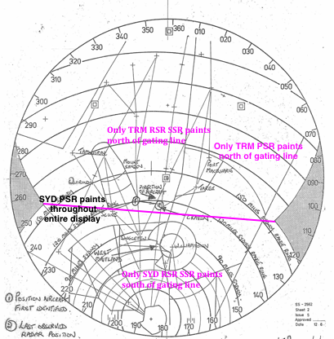
Electronic gating line
BWRS first to apply gating line logic to VH-MDX

Slide 23
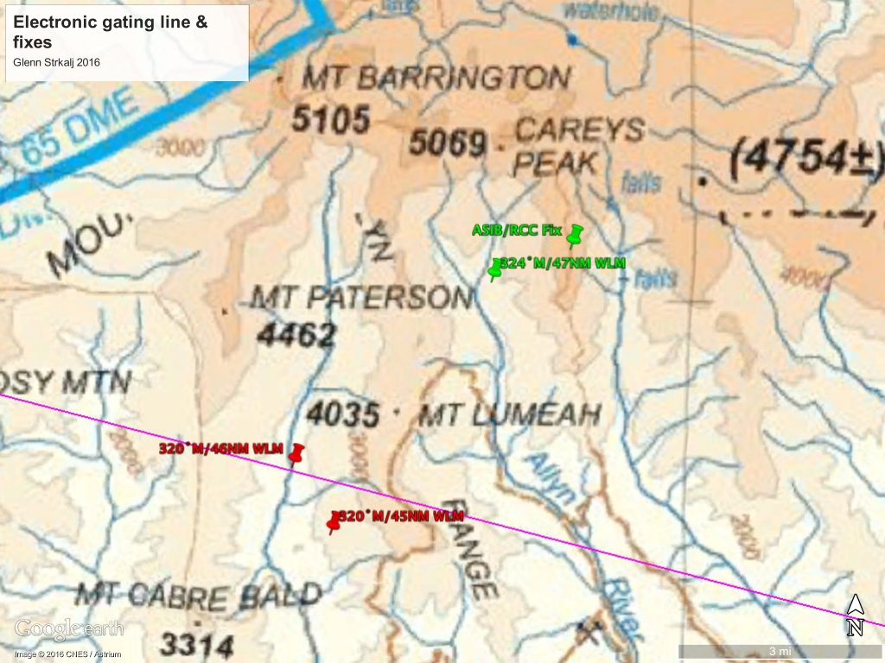
Gating line & fixes

Slide 24
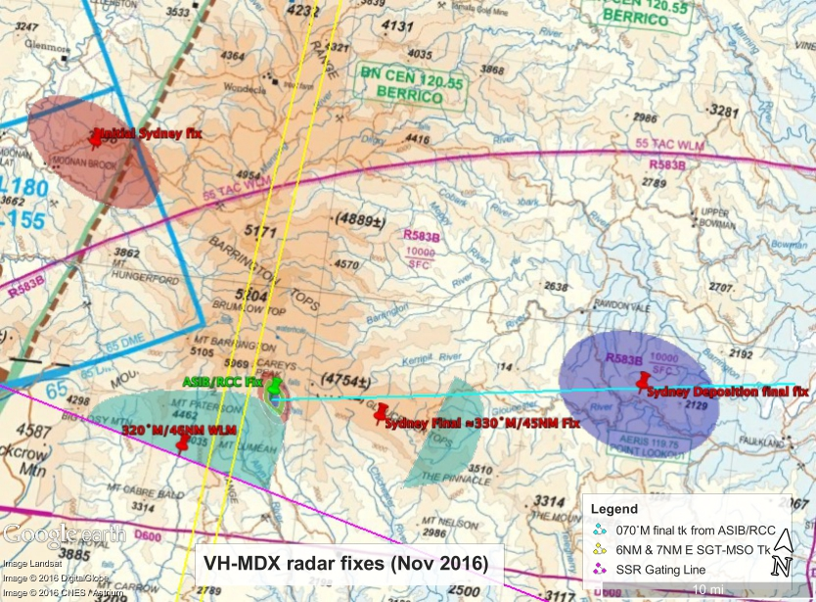
Reported radar fixes
Documentation reveals:
1x Initial fix
1x intermediate fix
5x final fixes!
BWRS analysis suggests:
1x initial fix
2x intermediate fixes
1x final fix
1x questionable final fix

Slide 27
Analysis of radar fixes
Now (2016) a strong understanding of VH-MDX radar fixes
Still more work to be done
Radio propagation analysis continues
Newly located information and data has confirmed many of our assumptions were solid

Slide 28
Radio propagation
Continues to offer more insight

Slide 29
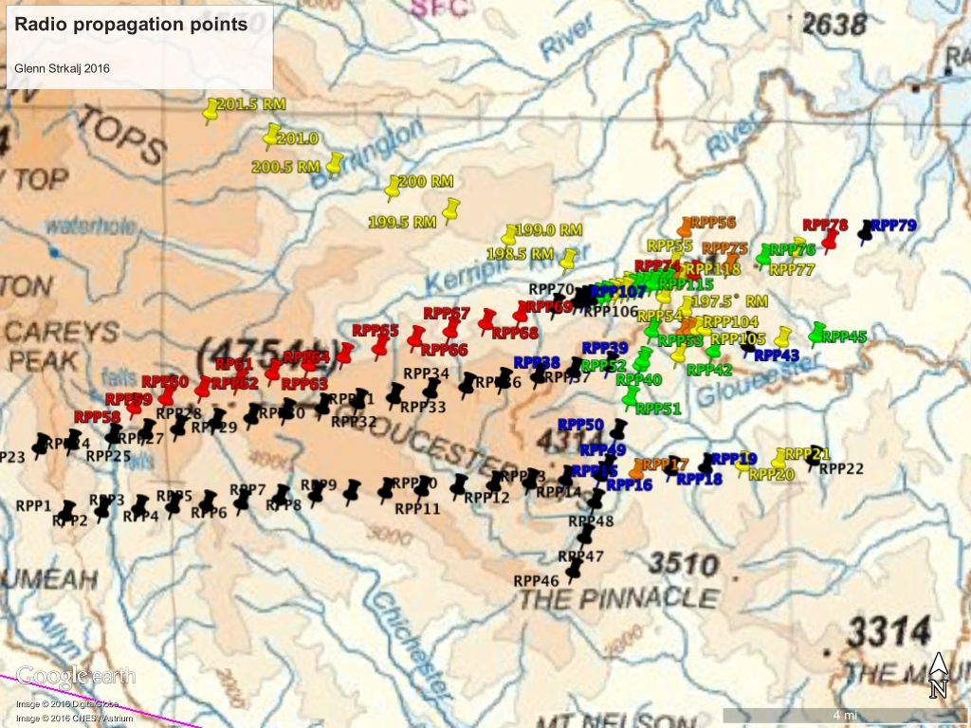

Slide 30
DoT Radio propagation

Slide 31
DoT TRM clutter diagram

Slide 32
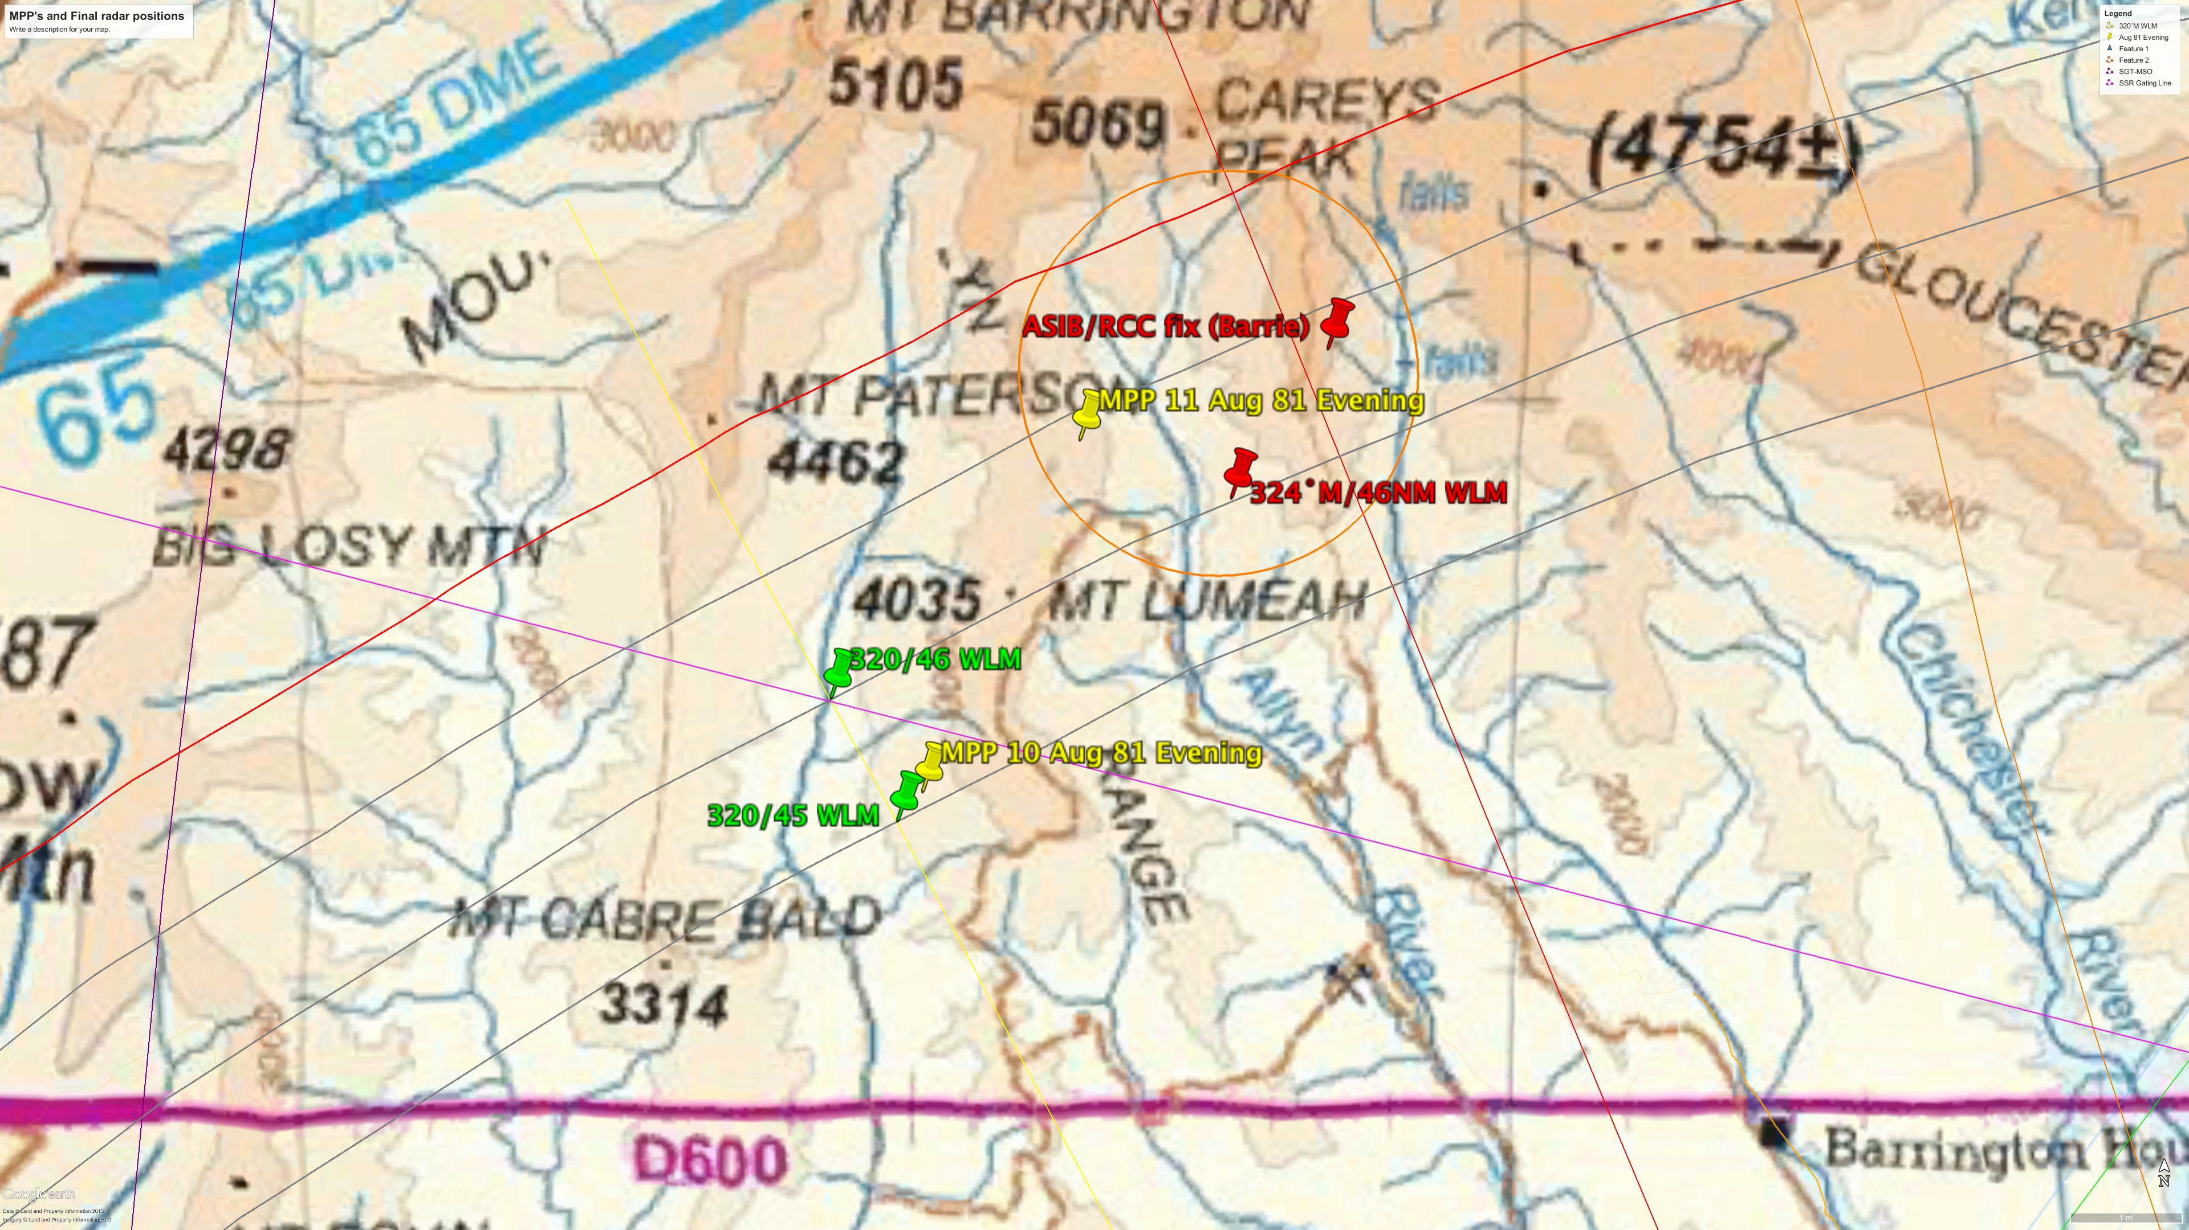
0936:00UTC WLM FIX

Slide 33
Current VH-MDX areas of interest
The Most Probable Area (MPA) suggests a smaller area based on the best current interpretation of current information and data
The MPA is not the only area within the MLE boundary that we are interested in!

Slide 34
Current VH-MDX areas of interest
MLE is 644sqkm (455sqkm if cleared areas and the Barringtons are only considered)
The MLE was amended in last quarter 2015
A 518sqkm reduction in area resulted
Primary search area ≈10km-20km east of legacy search areas
This includes: Gloucester, Wangat, and Kerripit rivers and valleys in between

Slide 35
VH-MDX areas of interest
We have developed and will continue to develop ‘sub-theories’ to isolate smaller target areas to search
What are sub theories?
Individual scenarios that were possible: e.g.:
departed flight just after final call
Flew with lateral control into ground +30 seconds after final call
Took a track following radar fade of 5˚north of last radar observed track
There are many possibilities!

Slide 36
VH-MDX areas of interest
What is different to BWRS areas and those of other researchers?
Other researches specify what in reality are only ‘sub theories’
Our deep research suggests that small areas of interest are not possible to specify with confidence: there are many possibilities!
If VH-MDX is found in one of these small areas it is more luck than science (but you tell this to the researcher involved)
the information currently does not support development of small areas and is unlikely to do so
BWRS offers an almost certain area VH-MDX is within with the MLE
Our area development is progressive, open for all to see and extremely thorough.

Slide 37
Remote sensing
In 2016 BWRS negotiated a deal to use Lidar data
Glenn Horrocks (BWRS) has developed software to interpret reflectivity levels of returns
The idea was originally suggested by Grahame Price (BWRS) many years ago
The software is in it’s infancy and will be developed to conduct shape and contrast recognition
Used at the 2016 SAREX: currently we are good at identifying creeks ☺
Also generate very accurate topo maps

Slide 38
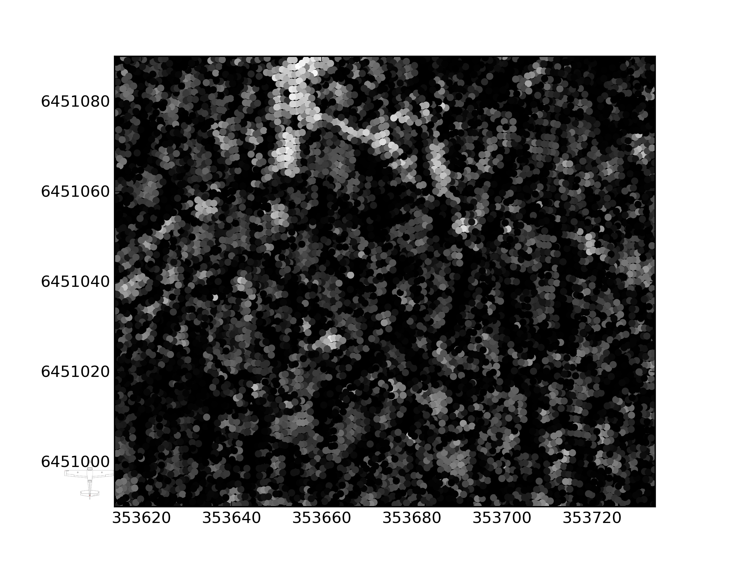

Slide 39
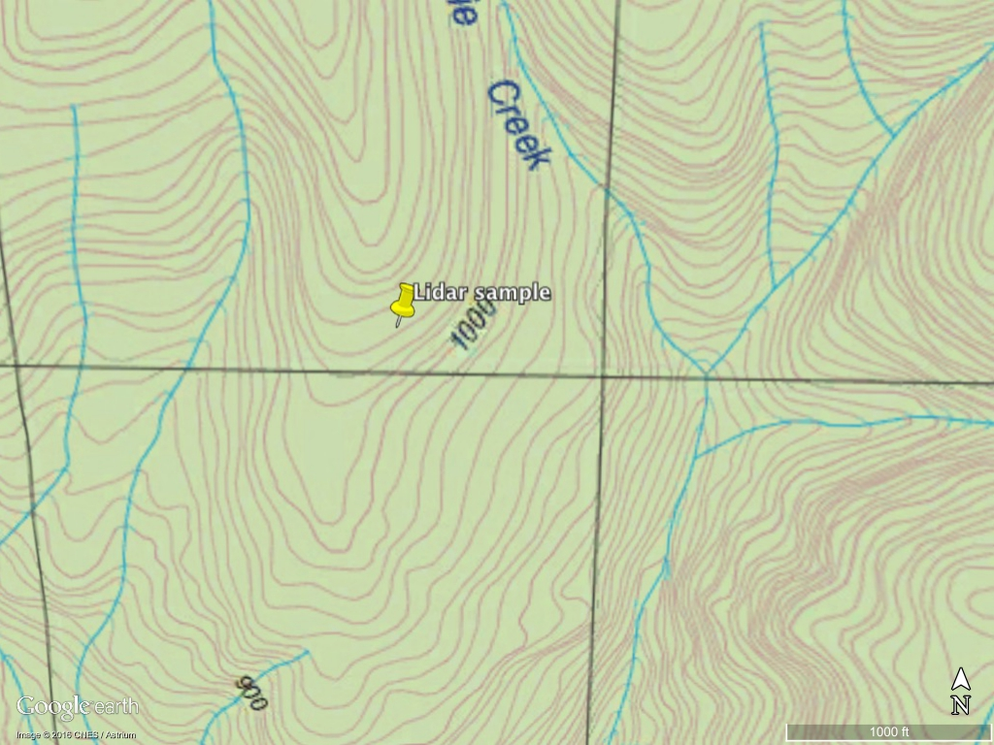

Slide 41
Aerial imagery
Aerial imagery has limited application to finding VH-MDX as it is likely the aircraft was ‘swallowed’ by the vegetation
Various agencies overviewed aerial photos in 1981
Landsat satellite was used but poor res (80m x 80m) and run was not through centre of the search area
An infra-red line scan was carried out by an RF-111C
Google Earth and Six map images are unlikely to locate VH-MDX and generate many false positives
But it is still possible that the above resources could locate VH-MDX: why?
If agencies did not focus on our current areas of interest
If the aircraft has slipped to a clear area or vegetation has died
Effort for likely outcome is not very efficient

Slide 42
The End
Questions?

